Slide 1


CSCI 1304: Programming I Chapter 1 Introduction Part 1 Computer Basics
Dr. Nour Almadhoun Alserr
Lecture 2-4
Week 2
Notes:
Overcome Challenges

Slide 2
Objective
Understand the basics of computer hardware and software
Hardware and Memory
Programs

Slide 3
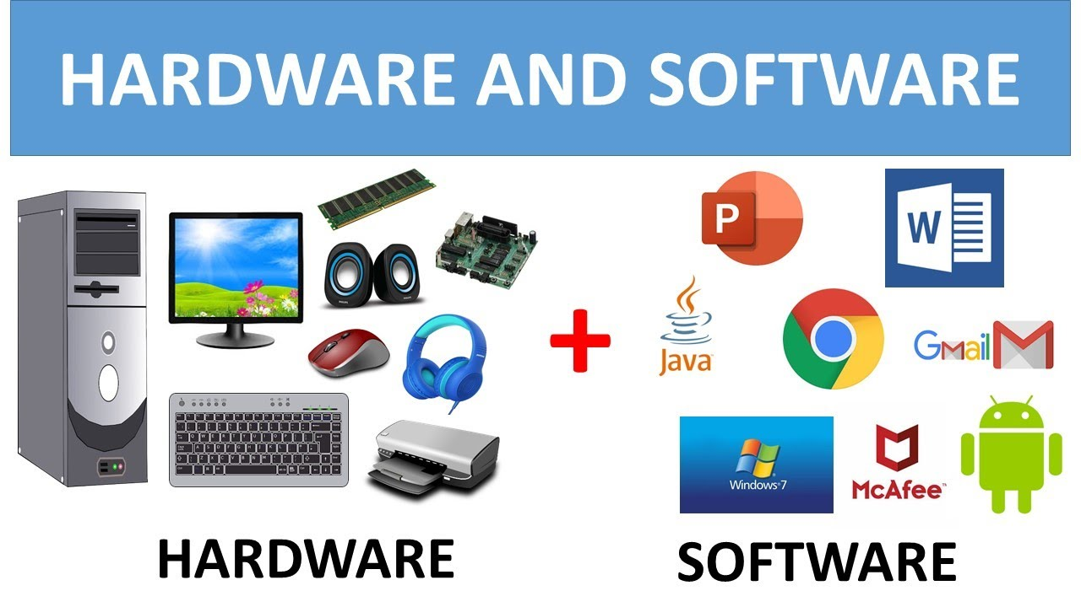
Hardware (HW) and Software (SW)
Computer systems consist of hardware and software.
https://www.youtube.com/watch?v=zlT-Lg_QFTA

Slide 4
Hardware (HW) and Software (SW)
Hardware includes the physical parts of computer systems.
Software includes programs - sets of instructions for the computer to follow.
Familiarity with hardware basics helps us understand software.
Notes:
Tangible = physical محسوسه وماديه

Slide 5
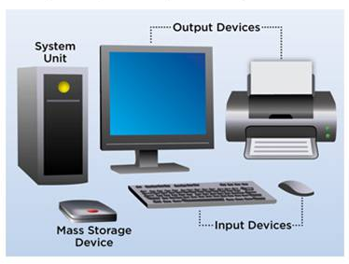
Hardware (HW)
Most modern computers have similar components including:
3
2
(Processor)
4
(Memory)
1
https://www.educba.com/computer-input-devices/
Notes:
Processor

Slide 6
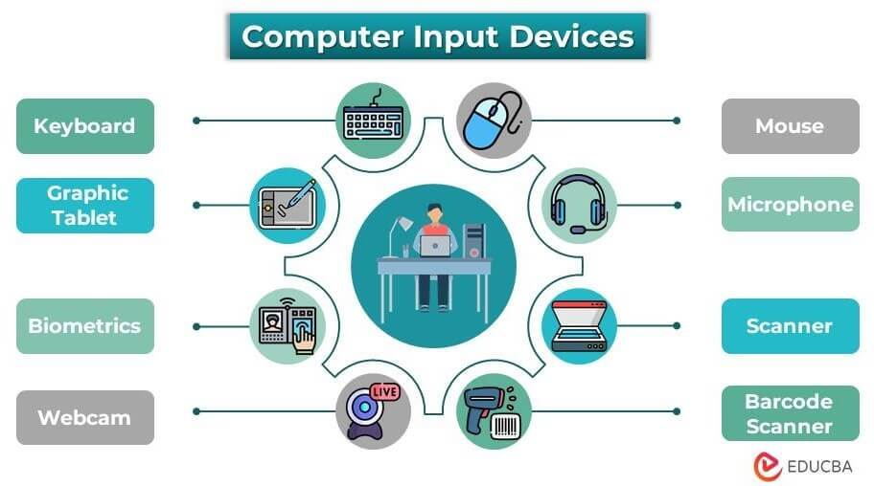
Hardware (HW)
Most modern computers have similar components including:
Input devices (keyboard, mouse, etc.)
https://www.educba.com/computer-input-devices/

Slide 7
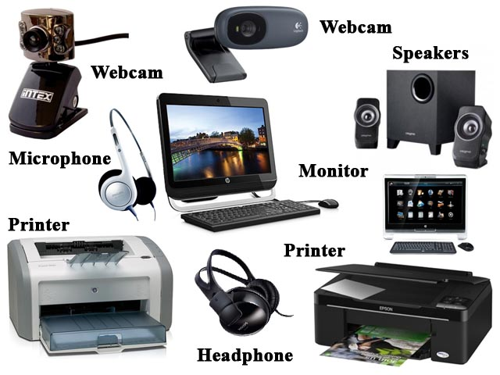
Hardware (HW)
Most modern computers have similar components including:
Output devices (display screen, printer, etc.)

Slide 8
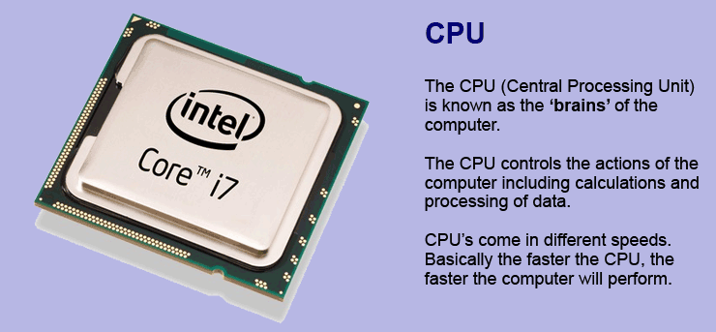
Hardware (HW)
Most modern computers have similar components including:
A processor
https://www.ictlounge.com/html/computercomponents.htm

Slide 9
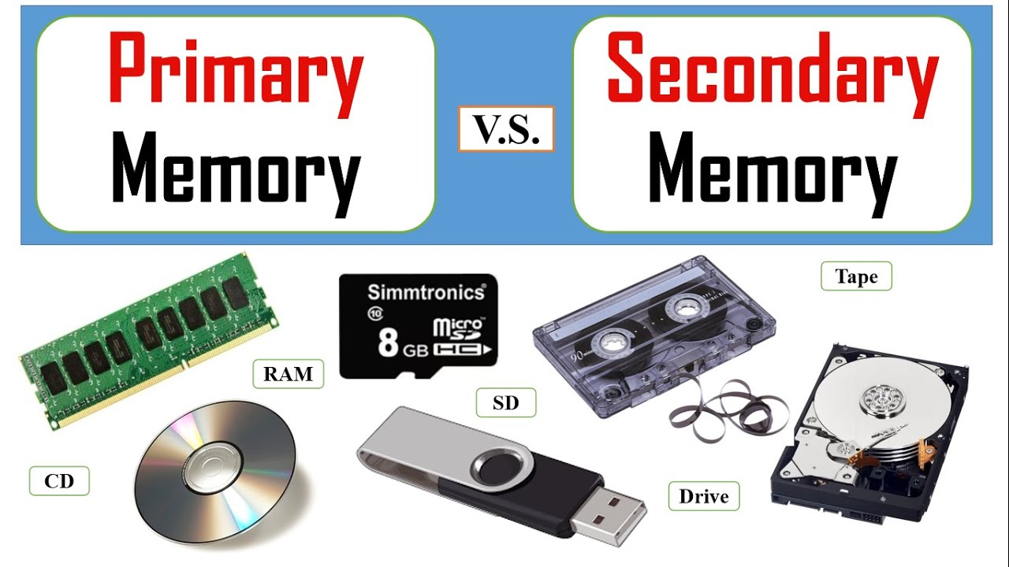
Hardware (HW)
Most modern computers have similar components including:
Two kinds of memory (main memory and auxiliary/secondary memory).
https://www.youtube.com/watch?app=desktop&v=yb46pDgLt00

Slide 10
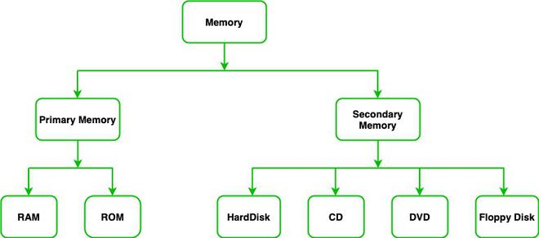
Hardware (HW)
Most modern computers have similar components including:
Two kinds of memory (main memory and auxiliary/secondary memory).
https://www.educba.com/computer-input-devices/

Slide 11
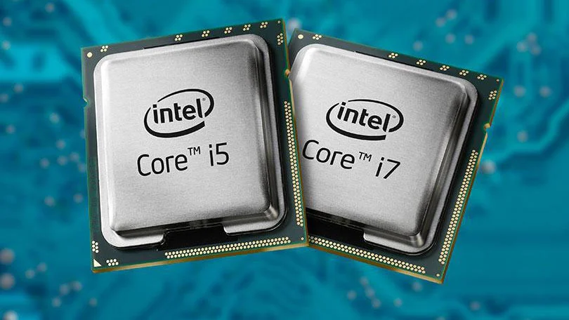
Processor
Also called the CPU (central processing unit) or the chip (e.g. intel Core i7).
Notes:
Pentium (single core)

Slide 12
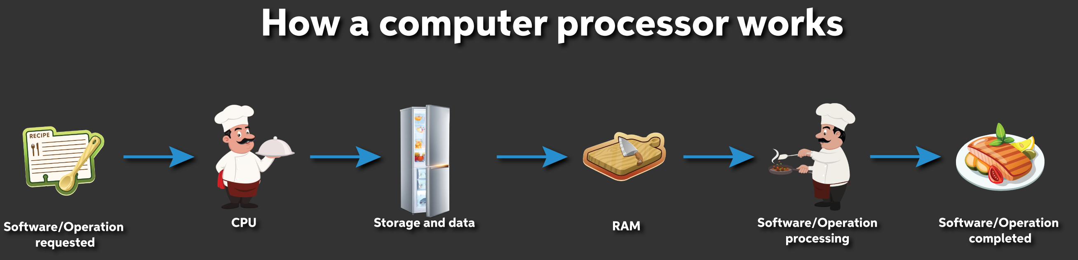
Processor
The processor processes a program’s instructions.
It can process only very simple instructions.
The power of computing comes from speed and program complexity.
https://www.sweetwater.com/sweetcare/articles/pc-processors-explained/
Notes:
Customer: You
Recipe: The software/operation (e.g., opening a folder, loading a song)
Ingredients: Data
Chef: Processor
Core: The faster the chef (and the number of chefs), the quicker the meal will be completed
Countertop: RAM — the bigger the countertop, the more you can prep quickly and efficiently
Refrigerator: Storage — the more disorganized the fridge, the harder it is to find the ingredients

Slide 13
Memory
Memory holds
Programs
Data for the computer to process
The results of intermediate processing
Two kinds of memory
Main memory
Auxiliary memory

Slide 14
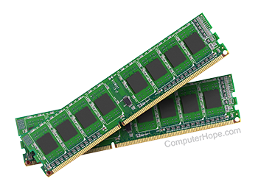
Main Memory
Working memory used to store
The current program
The data the program is using
The results of intermediate calculations
Usually measured in megabytes (MB) and gigabytes (GB) (e.g. 8 gigabytes of RAM)
RAM is short for random access memory
A byte is a quantity of memory
Notes:
8GB of RAM is the amount of memory we recommend for casual computer users. If your usage includes internet browsing, email, lots of office programs, flash games, and multitasking – this level of memory should be sufficient.

Slide 15
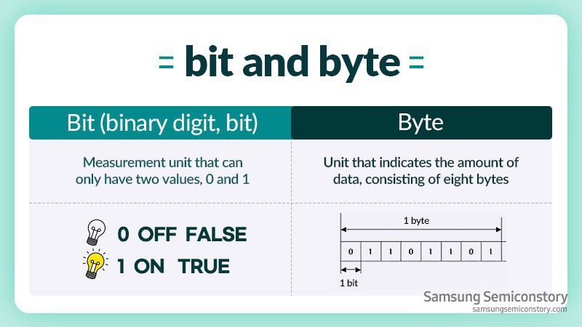
Bit and Byte
bits
https://semiconductor.samsung.com/us/support/tools-resources/dictionary/bits-and-bytes-units-of-data/

Slide 16
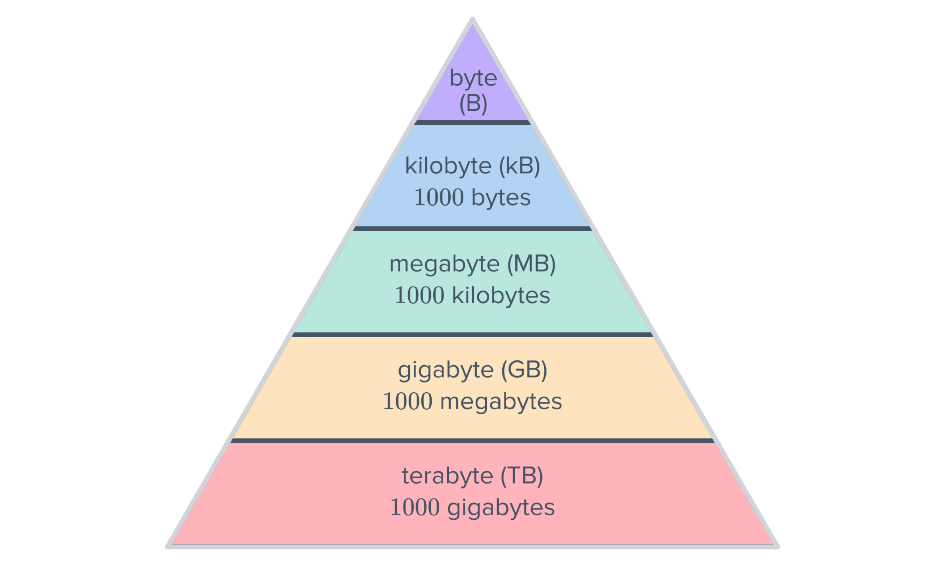
Bit and Byte
https://mathspace.co/textbooks/syllabuses/Syllabus-1016/topics/Topic-20101/subtopics/Subtopic-267734/

Slide 17
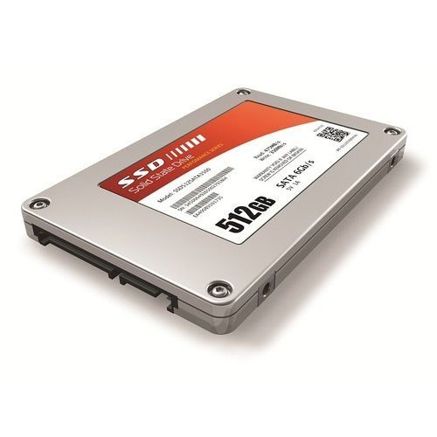
Secondary (Auxiliary) Memory
Disk drives, CDs, DVDs, flash drives, etc.
More or less permanent (nonvolatile)
Usually measured in gigabytes (GB) (e.g. 512 gigabyte hard drive)
Notes:
8GB of RAM is the amount of memory we recommend for casual computer users. If your usage includes internet browsing, email, lots of office programs, flash games, and multitasking – this level of memory should be sufficient.

Slide 18
Memory
Volatile memory stores data when a computer is on but erases it as soon as the computer is switched off (e.g. RAM).
Non-volatile memory remains in a computer even after the system shuts off (e.g. hard disk).
Notes:
Volatile متطايره

Slide 19
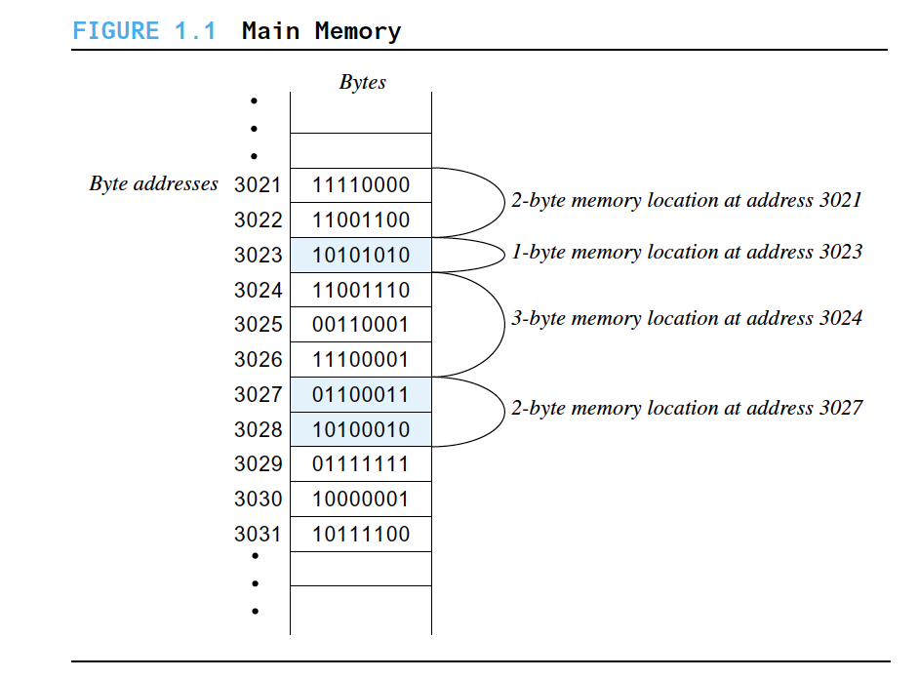
Bytes and Memory Locations
Java: An Introduction to Problem Solving and Programming, 8th Edition, By Walter Savitch, Pearson (2017).
Notes:
A computer’s main memory is divided into numbered units called bytes.
The number of a byte is called its address. Each byte can hold eight
binary digits, or bits, each of which is either 0 or 1. To store a piece of
data that is too large to fit into a single byte, the computer uses several
adjacent bytes. These adjacent bytes are thought of as a single, larger
memory location whose address is the address of the first of the adjacent
bytes.

Slide 20
Storing Data
Data of all kinds (numbers, letters, strings of characters, audio, video, even programs) are encoded and stored using 1s and 0s.
When more than a single byte is needed, several adjacent bytes are used.
The address of the first byte is the address of the unit of bytes (Groups of adjacent bytes can serve as a single memory location).

Slide 21

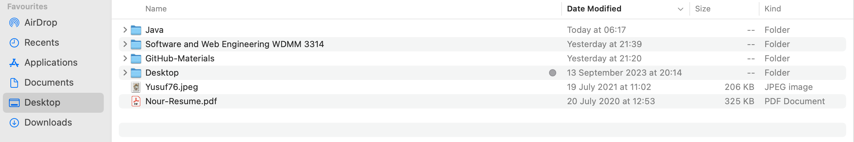
Files
Large groups of bytes in auxiliary memory are called files.
Files have names.
Files are organized into groups called directories or folders.
https://www.youtube.com/watch?app=desktop&v=k-EID5_2D9U

Slide 22
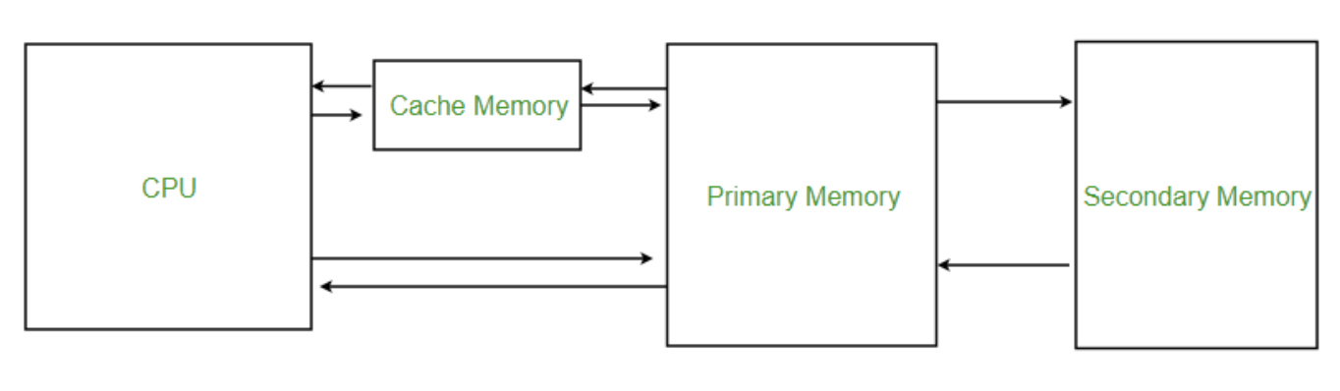
Files
Java programs are stored in files.
Programs files are copied from auxiliary memory to main memory in order to be run.
Stored
https://www.geeksforgeeks.org/cache-memory-in-computer-organization/

Slide 23
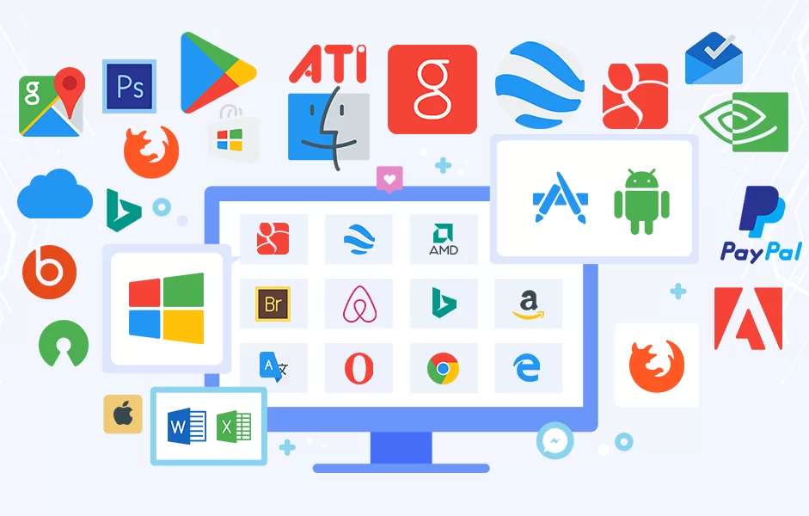
Programs
A program is a set of instructions for a computer to follow.
We use programs almost daily (email, word processors, video games, bank ATMs, etc.).
Following the instructions is called running or executing the program.
https://www.goodcore.co.uk/blog/types-of-software/

Slide 24
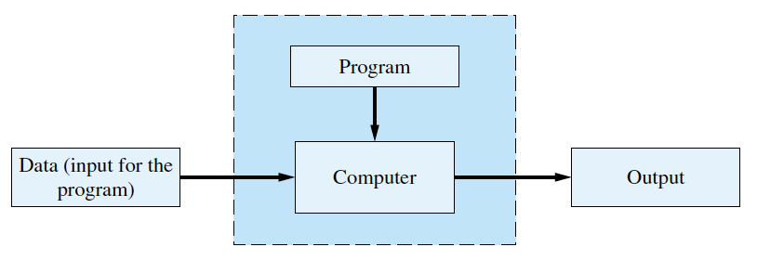
Running a Program
Notes:
Normally, a computer receives two kinds of input:
The program
The data needed by the program.
The output is the result(s) produced by following the instructions in the program.
Sometimes the computer and the program are considered to be one unit.

Slide 25
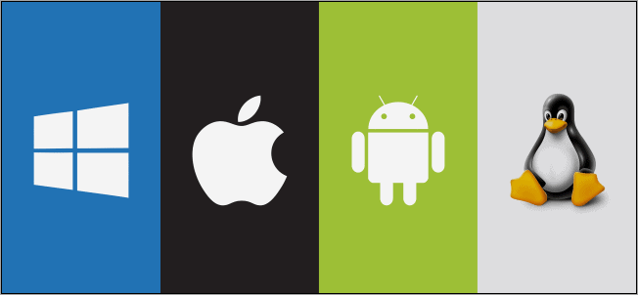
Operating System (OS)
The OS is a supervisory program that oversees the operation of the computer.
The operating system retrieves and starts program for you.
Well-known OS
https://www.softwaretestinghelp.com/best-operating-systems/
Notes:
a program that acts as an interface between the computer user and computer hardware, and controls the execution of programs.

Slide 26
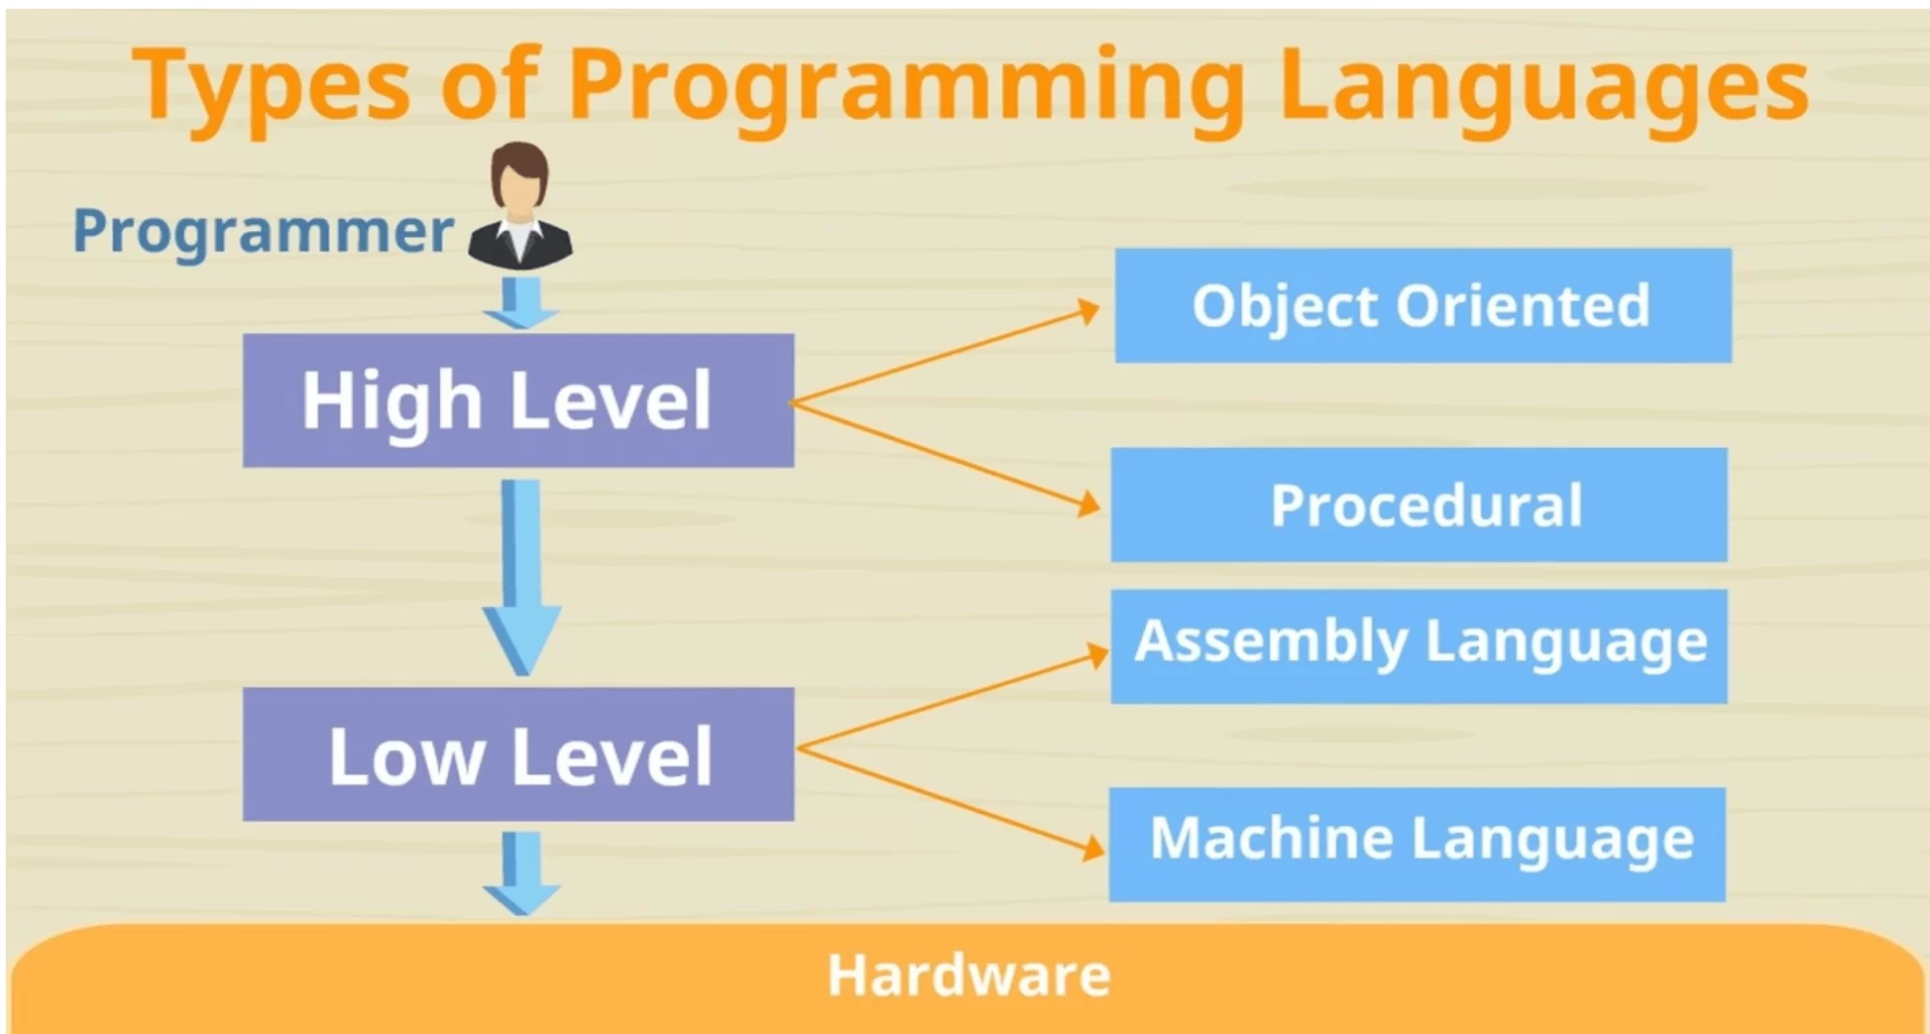
Programming Languages
High-level languages are relatively easy to use.
Java, C#, C++, Visual Basic, Python, Ruby.
Unfortunately, computer hardware does not understand high-level languages.
https://inprogrammer.com/high-level-vs-low-level/
Notes:
Therefore, a high-level language program must be translated into a low-level language.

Slide 27
Compilers
Compiler
High-Level Language
Low-Level Language
Different types for different OS, large, expensive to produce.
machine- or assembly-language
Compilation Error
Source program
Object program
Translating the entire program at once
Notes:
A compiler translates a program from a high-level language to a low-level language the computer can run.
You compile a program by running the compiler on the high-level-language version of the program called the source program.
Compilers produce machine- or assembly-language programs called object programs.

Slide 28
Java Compilers
High-Level Language
Java Compiler
(Translation)
Low-Level Language
Java Program
(.java)
Java language
Machine language for Java Virtual Machine (JVM)
Byte-code
(.class)
Byte-code: easy to translate into machine language for any particular computer (Java is platform independent).
Notes:
Instead, it translates a Java program into byte-code.
Byte-code is the machine language for a hypothetical computer (or interpreter) called the Java Virtual Machine.

Slide 29
JVM Interpreter
Interpreter
JVM
Translates (to machine language) and
executes
bytecode
Bytecode
Just-In-Time or JIT compiler
Executes a portion of code
right after translating it.
A compiled program generally runs faster than an
interpreted one.
Notes:
A program called an interpreter translates each byte-code instruction, executing the resulting machine-language instructions on the particular computer before translating the next byte-code instruction.
Most Java programs today are executed using a Just-In-Time or JIT compiler in which byte-code is compiled as needed and stored for later reuse without needing to be re-compiled.

Slide 30
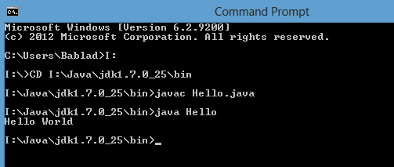
Compiling, Interpreting, Running
Use the compiler to translate the Java program into byte-code.
Use the JVM for your computer to translate each byte-code instruction into machine language and to run the resulting machine-language instructions.
https://javaconceptoftheday.com/javac-command-and-java-command/

Slide 31
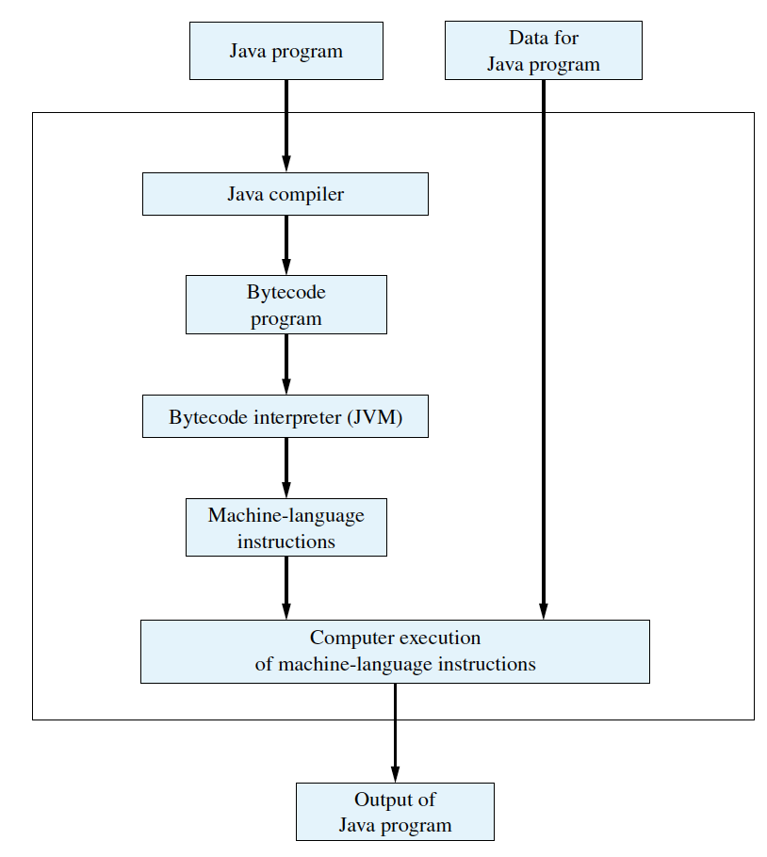
Compiling, Interpreting, Running
Java: An Introduction to Problem Solving and Programming, 8th Edition, By Walter Savitch, Pearson (2017).

Slide 32
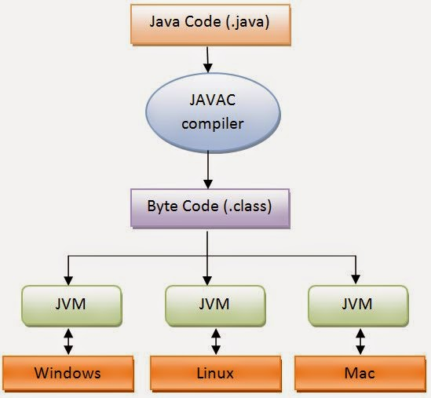
Portability
Bytecode can be used on any computer.
Bytecode can be sent over the Internet and used anywhere in the world.
This makes Java suitable for Internet applications.
https://devrant.com/rants/2096719/which-programming-languages-can-create-portable-programs-that-can-run-on-every-o
Notes:
After compiling a Java program into byte-code, that byte-code can be used on any computer with a byte-code interpreter and without a need to recompile.
Byte-code can be sent over the Internet and used anywhere in the world.
This makes Java suitable for Internet applications.

Slide 33
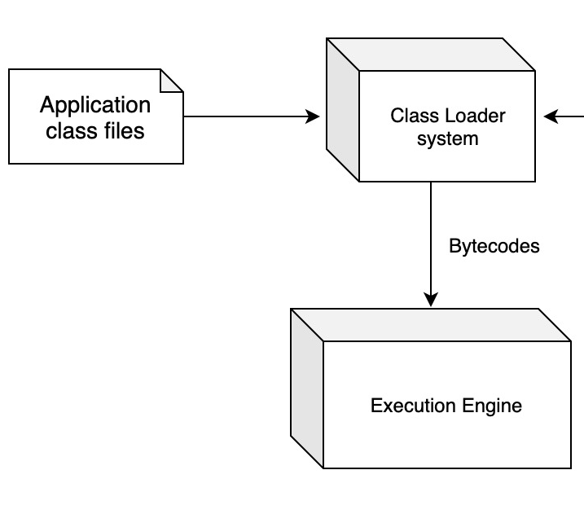
Class Loader
A Java program typically consists of several pieces called classes.
Each class may have a separate author and each is compiled (translated into byte-code) separately.
A class loader (called a linker in other programming languages) automatically connects the classes together.
https://dzone.com/articles/java-virtual-machine-internals-class-loader

Slide 34

Do you have
any QUESTIONS??
Notes:
Do you have any Questions?

